Slide 1
Digital Logic Design and Application
Lecture #07

Slide 2
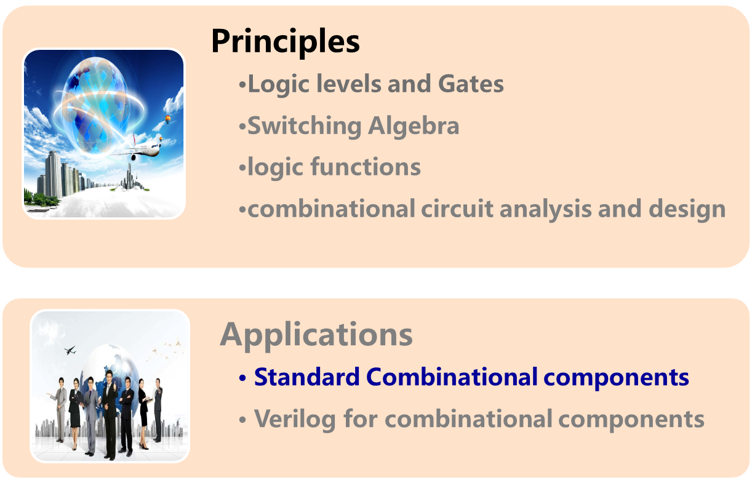
Topic 2-1 combinational circuits design

Slide 3
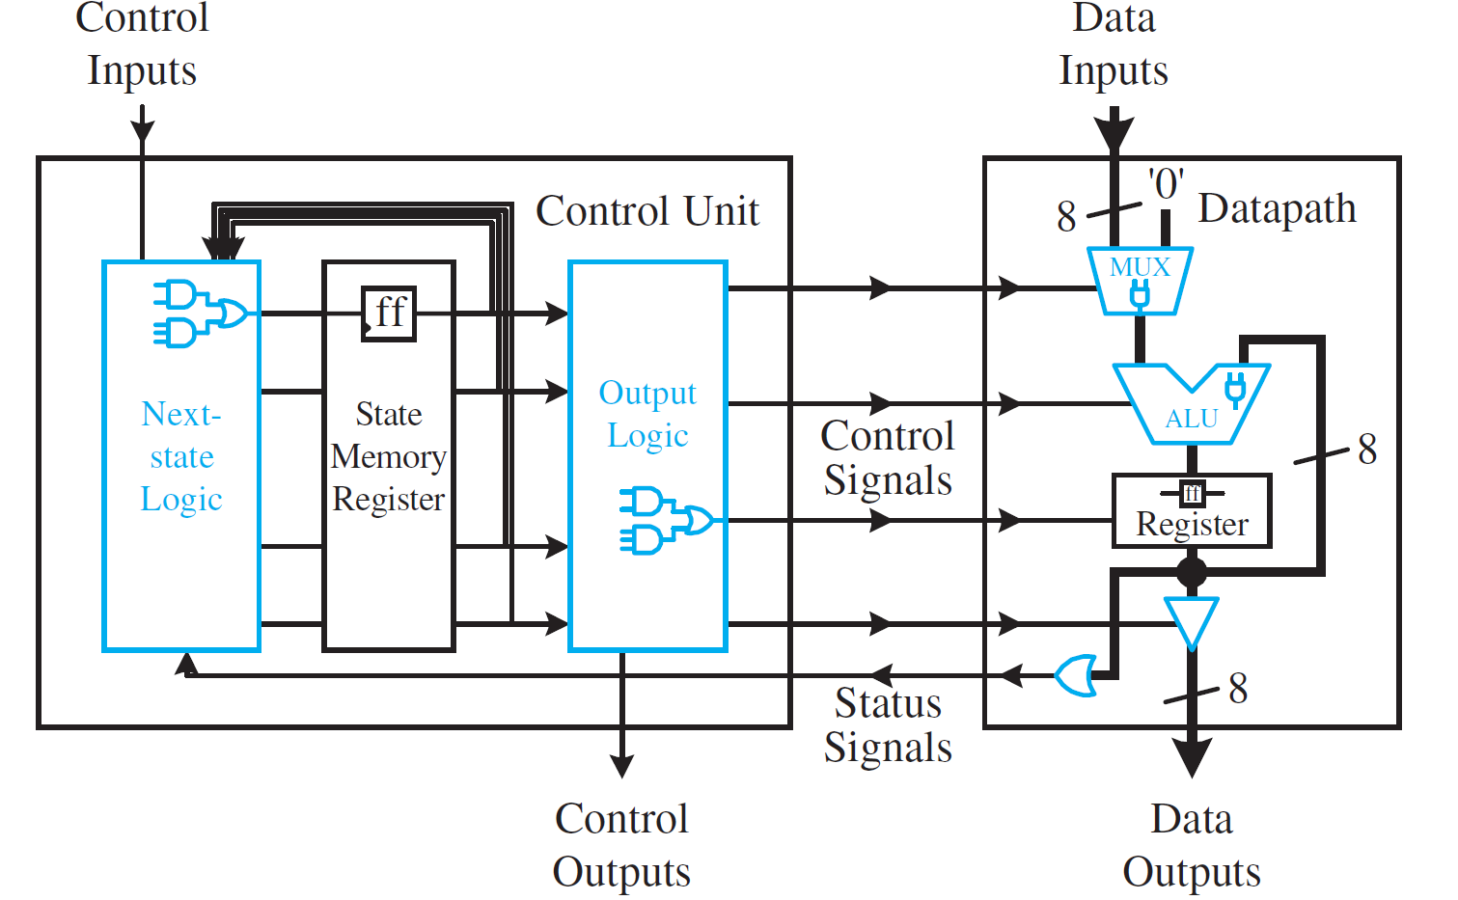
Organization of Center Processor Unit
P65

Slide 4
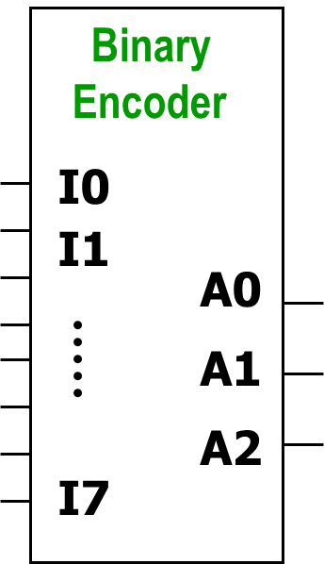
* Binary Encoders（二进制编码器）
Binary encoder: can be used to generate a set of binary codes for a valid input signal.
  Only one input is asserted and the output is the corresponding binary codes.
  convert decimal code to binary codes, its essence is a code conversion decoder.
  Multiple-Input, Multiple-Output Logic Circuit
  Output code has fewer bits than its input code.
  2^{n}-to-n encoder
  Eg. 4-2 encoder, 8-3 encoder….
1
1
1
1
0
0
0
1
Notes:
If a signal is H or logic 1 it is asserted.

Slide 5
8-to-3 Encoder
Truth Table for a 8-to-3 Encoder
One–out-of-2³
I0 I1 I2 I3 I4 I5 I6 I7
A2 A1 A0
1 0 0 0 0 0 0 0 0 0 0
0 1 0 0 0 0 0 0 0 0 1
0 0 1 0 0 0 0 0 0 1 0
0 0 0 1 0 0 0 0 0 1 1
0 0 0 0 1 0 0 0 1 0 0
0 0 0 0 0 1 0 0 1 0 1
0 0 0 0 0 0 1 0 1 1 0
0 0 0 0 0 0 0 1 1 1 1
3- bit
binary
Guarantee:
Only one input is asserted(有效) at any time. Logic 1 for asserted.
There are only 8 effective input combinations within the 2⁸ theoretical combinations.

Slide 6
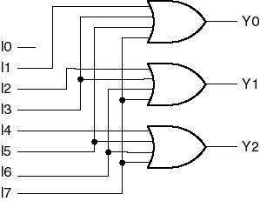
8-to-3 Encoder
Guarantee:
Only one input is asserted at any time.
0
0
0
Truth Table for a 8-to-3 Encoder
0
0
.
.
.
0
I0 I1 I2 I3 I4 I5 I6 I7
A2 A1 A0
1 0 0 0 0 0 0 0 0 0 0
0 1 0 0 0 0 0 0 0 0 1
0 0 1 0 0 0 0 0 0 1 0
0 0 0 1 0 0 0 0 0 1 1
0 0 0 0 1 0 0 0 1 0 0
0 0 0 0 0 1 0 0 1 0 1
0 0 0 0 0 0 1 0 1 1 0
0 0 0 0 0 0 0 1 1 1 1
A0 = I1 + I3 + I5 + I7
A1 = I2 + I3 + I6 + I7
A2 = I4 + I5 + I6 + I7
Input I₀ is not connected, which means when other inputs are de-asserted(无效) the output is the encode word for I₀.

Slide 7
8-to-3 Priority Encoder(优先编码器)
Guarantee:
Only one input is asserted at any time.
Request
encoder
REQ0
requestor’s
number
REQ1
Requests
for
service
The trouble:
When more than one inputs are asserted?
REQ7
—— assign priority（优先级） to the inputs
Notes:
Systems like calling systems in hospital need to respond to multiple request inputs, then in order to decide which request input is to be respond first the priorities of multiple inputs must be assigned in advance.

Slide 8
8-3 Priority Encoder
I7 has the
Highest-Priority
Outputs A2~A0 indicate the number of the highest-priority input asserted at the moment.
I7
I6
I5
I4
I3
I2
I1
I0
A2
A1
A0
IDLE
Define intermediate variables H0~H7:
H_{i} is asserted if (input I_{i} is asserted) and (I_{i} has the highest priority).
Inputs with higher priority must be de-asserted, Inputs with lower priority are ignored.
H7 = I7
H6 = I6 · I7’
H5 = I5 · I6’ · I7’
…
H0 = I0 · I1’ · I2’ · … · I6’ · I7’
If A2A1A0=“101” →

Slide 9
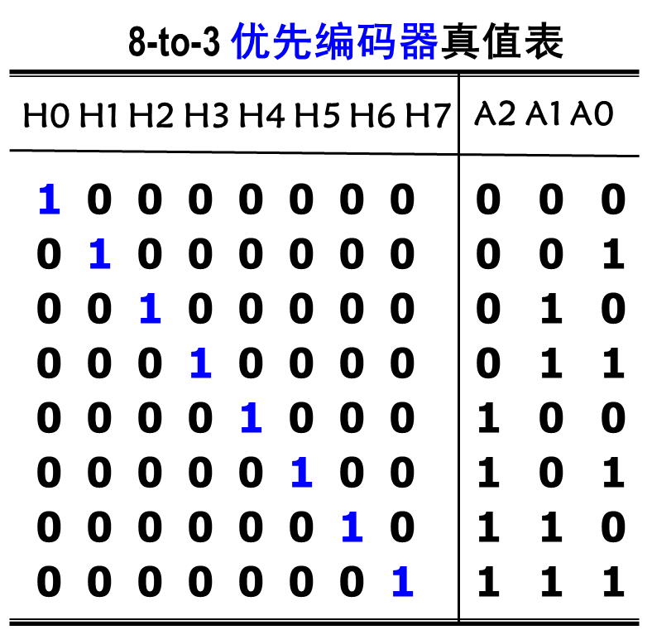
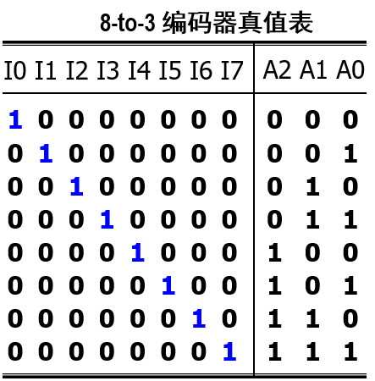
8-3 Priority Encoder
8-3 Priority Encoder functional table
Hi ↔ Ii
Notes:
与8-3编码器的真值表对比，不难发现，优先编码器的中间变量Hi与编码器的输入变量Ii有对应关系。

Slide 10
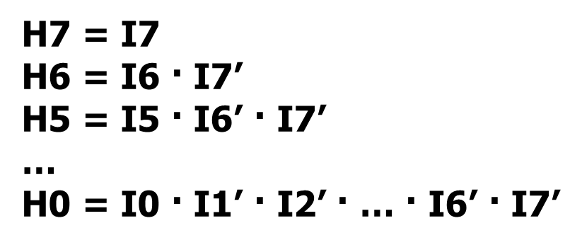
Logic equation for 8-3 encoder
Logic equation for 8-3 priority encoder
A2 = H4 + H5 + H6 + H7
A1 = H2 + H3 + H6 + H7
A0 = H1 + H3 + H5 + H7
A0 = I1 + I3 + I5 + I7
A1 = I2 + I3 + I6 + I7
A2 = I4 + I5 + I6 + I7
_{Substitute into}
Hi ↔Ii
Notes:
由于Hi和Ii的对应关系，我们只需要用Hi去替换8-3编码器的输入输出逻辑表达式中的Ii，然后将Hi与输入Ii的关系式代入这个表达式，就可以得到优先编码器的输入输出逻辑表达式。具体表达式参教材相关章节。
得到表达式之后，通过逻辑函数的变形就可以得到由标准的与非门实现的优先编码器电路。

Slide 11
8-3 Priority Encoder
What If A2A1A0=“000” ?
No inputs
Only I0 is asserted
I7
I6
I5
I4
I3
I2
I1
I0
A2
A1
A0
IDLE
Need to add an IDLE output which is asserted if no inputs are asserted.
IDLE =I0’ I1’ · … · I6’ · I7’
I0 … I7=10…0, A2A1A0=“000”, IDLE =0→Only I0 is asserted
I0 … I7=0..…0, A2A1A0=“000”, IDLE =1→ no input
Notes:
Ii均无效时，Hi=0，=>Ai=0. A2A1A0=000.

Slide 12
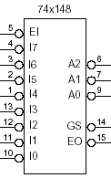
Standard MSI Encoder Components
The 74x148 Priority Encoder
an invert bubble on the input and output pin indicates an active low level.
Enable
Input
EI
address
outputs
data
inputs
GS
Group Select(组选)
EO
Enable Output,

Slide 13
Singnal name and active level
We can associate a signal’s active level with its name.
Active high input (output): signal is asserted when signal=1 (H);
Active low input (output): signal is asserted when signal=0 (L).
half 74x139
G_L
G
A
B
Y0
Y1
Y2
Y3
Y0_L
Y1_L
Y_{i} _L = Y_{i} ’
A
Y2_L
B
Y3_L
↑
Active high
高电平有效
↑
Active Low
低电平有效
Notes:
It is better to treat the inputs and outputs as active high within a logic symbol.

Slide 14
Logic Symbols for Digital Element
1/2 74x139
1/2 74x139
half 74x139
G
A
B
Y0
Y1
Y2
Y3
G
A
B
Y0
Y1
Y2
Y3
G_L
G
A
B
Y0
Y1
Y2
Y3
Y0_L
Y1_L
A
Y2_L
↑
correct but
to be avoided
B
Y3_L
↑
incorrect
↑
Active high
高电平有效
↑
Active Low
低电平有效
Always define the signal names according to the function within the symbol frames.
It is better to treat the inputs and outputs as active high within a logic symbol.

Slide 15
The 74x148 Priority Encoder
When EI _L is deasserted (EI_L=1), all outputs are deasserted (A_{i}_L=1).
Enable Input
EI_L
EI
I7_L
I6_L
.
.
.
.
I0_L
A2_L
A1_L
A0_L
GS is asserted when at least one input is asserted
GS
GS_L, Group Select(组选)
EO
EO_L, Enable Output
(IDLE)
EO is asserted when no input is asserted
GS=EO’

Slide 16
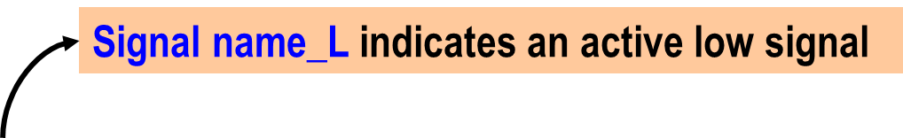
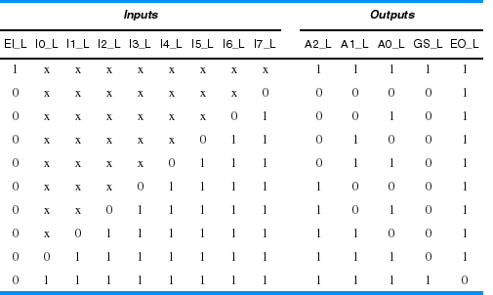
Truth table for a 74x148 8-input priority encoder
1
1 1 1 1 1
0
0
0 0 0
0 1 1 1 1 1 1 1 1
1 1 1
1 0

Slide 17
Binary Decoders（二进制译码器）
Decoding is the reverse process of encoding, which translates the binary input states into binary code output, to reveal its original meaning.
Input
code word
Map
output
code word
enable
inputs
  Multiple-Input, Multiple-Output Logic circuit .
  Inputs generally have fewer bits than outputs.
  one-to-one mapping from the input code words into the output code words.
  Enable Inputs must be asserted to perform its decoding function.
Yan Chen. UESTC

Slide 18
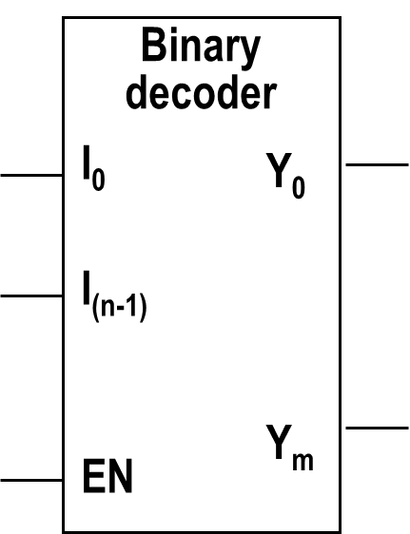
Binary Decoders
Binary Decoders
  a.k.a. variable decoders, Minterm decoders, 1-out-of-m decoders
  Map n bits input to m bits(m≤2^{n}).
  Correspond to every input combination only one output is asserted.
  Output Y_{i} is asserted when the inputs (I_{n-1}….I₀)_{B}= (i)_{D}
  Binary decoder is suitable for any application that needs to activate one of the 2^{n} outputs corresponding to n-bit inputs.
_{1-out of-m}
₀
₀
…
₀
₁₁
…
₁
₀₀
…
₀
₁
₁
₀
…
₀
_{Binary code}
…
………

Slide 19
2-4 Binary Decoders
Truth table for a 2-to-4 binary decoder
2-to-4
decoder
Inputs
EN I1 I0
Outputs
Y3 Y2 Y1 Y0
LSB
I0
I1
EN
Y0
Y1
Y2
Y3
LSB
MSB
0 X X 0 0 0 0
1 0 0 0 0 0 1
1 0 1 0 0 1 0
1 1 0 0 1 0 0
1 1 1 1 0 0 0
MSB
  Output Y_{i} is asserted →
  when the binary input combination = ( i )_{D}
Suppose all outputs are active high.

Slide 20
Binary Decoders
All outputs are active high.
Truth table for a 2-to-4 binary decoder
Inputs
EN I1 I0
Outputs
Y3 Y2 Y1 Y0
Y0 = EN · ( I1’ · I0’ )
Y1 = EN · ( I1’ · I0 )
Y2 = EN · ( I1 · I0’ )
Y3 = EN · ( I1 · I0 )
0 X X 0 0 0 0
1 0 0 0 0 0 1
1 0 1 0 0 1 0
1 1 0 0 1 0 0
1 1 1 1 0 0 0
Yi = EN · m_{i}
Note: m_{i} is the Minterm of the input variables(I₁ and I₀ )

Slide 21
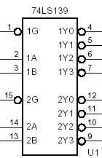
2-4 Binary Decoders
TTL family : LS, S, S, AL
CMOS family: H, HCT, VHCT, AC
74x139
Truth Table for 1/2 74x139
1Y0_{_L}
Inputs
iG_L iB iA
Outputs
iY3_L iY2_L iY1_L iY0_L
1 X X 1 1 1 1
0 0 0 1 1 1 0
0 0 1 1 1 0 1
0 1 0 1 0 1 1
0 1 1 0 1 1 1
… …
2Y3_{_L}

Slide 22
Cascading Binary Decoders
Q: Design 3-8 decoder using 74x139?
74x139
D0_L
D1_L
D4_L
D7_L
I0
I1
I2
Yan Chen. UESTC
Notes:
Use truth table to form the cascading logic.

Slide 23
Using decoders to realize Sum of Products
F = ∑_{(X,Y,Z)} (0,3,6,7)
Yi = EN · m_{i}
EN = G1 ·G2A_L · G2B_L
when all of enable inputs are asserted, output Yi = m_{i}
74x138
G1
G2A
G2B
Y0
Y1
Y2
Y3
Y4
Y5
Y6
Y7
Y0_L
EN
Y1_L
Confirm the LSB and MSB
A
B
C
C B A
↓ ↓ ↓
X Y Z
Y7_L
↑
Active high
↑
Active Low
Y_{i} =m_{i}
Y_{i} _L = Y_{i} ’=m_{i}’

Slide 24
Example 1. using decoders to realize Sum of Products form
F = ∑_{(X,Y,Z)} (0,3,6,7)
74x138
+5V
m₀'
m₀
G1
G2A
G2B
Y0
Y1
Y2
Y3
Y4
Y5
Y6
Y7
m₁'
m₁
F
Z
Y
X
A
B
C
m₆
m₆'
m₇'
m₇

Slide 25
Example 1. using decoders to realize Sum of Products form
F = ∑_{(X,Y,Z)} (0,3,6,7)
74x138
+5V
G1
G2A
G2B
Y0
Y1
Y2
Y3
Y4
Y5
Y6
Y7
F
Z
Y
X
A
B
C

Slide 26
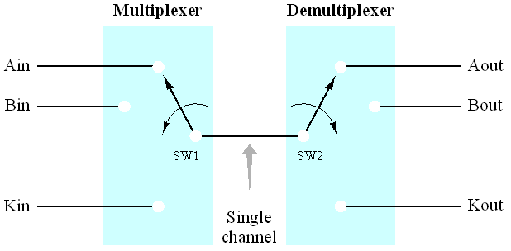
Multiplexer(多路数据选择器/复用器) & Demultiplexer
Data select and route (demultiplexing)
  Data select 1 from M sources
  Route the bus data to one of M destinations
M-to-1
1-to-M
SRCSEL
DSTSEL
Select signal bit width: Log₂(M) bit
Notes:
M data resource need M corresponding selecting signal, and they can be coded by Log₂(M) bit binary codes.

Slide 27
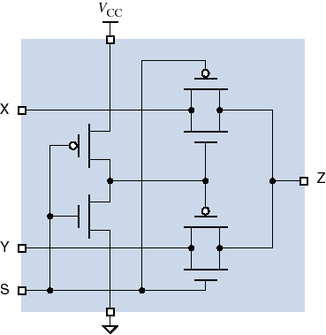
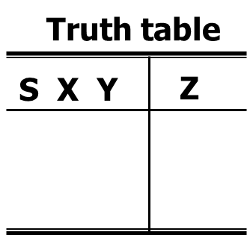
Multiplexer
1. General description of MUX
Digital Switch
Multi-Switch
Data Select
  数据选择器
ab. MUX
数据输入
X
2-to-1
Mux
Z
Y
S
控制输入
S=0 Z=X
X=1 Z=Y
0
X
X
X
Y
S’
S
Z= X + Y
1
X
X
Two level AND-OR circuit
Notes:
S=0代表了真值表中的4行，K-map中的四个相邻cell，这时合并之后只剩公因子S’；同理S=1，代表了真值表中的后4行，K-map中的四个cell，这时合并之后只剩公因子S；
也可以这样理解，当且仅当S=0时Z=X，当且仅当S=1时Z=Y，与X和Y的输入组合无关。

Slide 28

Multiplexer
1. General description of MUX
Design a 4-to-1 MUX
6 inputs and 1 out put
数据输入
D0
Truth table
4-to-1
Mux
Z
S1 S0
Z
D3
0
0
1
1
0
1
0
1
D0
D1
D2
D3
S1 S0
控制输入
S1’S0’ S1’S0 S1S0’ S1S0
Z= D0+ D1+ D2+ D3
m0 m1 m2 m3
Two level AND-OR circuit
Z=∑( m_{i}·D_{i})
Note: m_{i} is the Minterm of input control variables.
Notes:
Z=(S1S0=00)*D0+(S1S0=01)*D1+(S1S0=10)*D2+(S1S0=11)*D3
其中，
S1S0=00 使得m0=S1’*S0’=1
S1S0=01 使得m1=S1’*S0=1
S1S0=10 使得m2=S1*S0’=1
S1S0=11 使得m3=S1*S0=1
所以，Z=∑( m_{i}·D_{i})

Slide 29
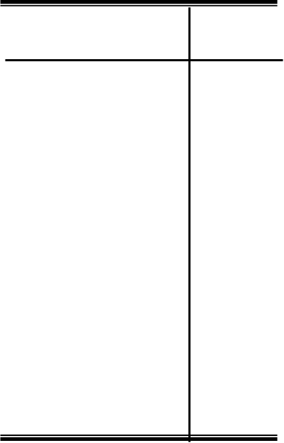
Multiplexer
Design a 8-to-1MUX
1. General description of MUX
11 inputs and 1 out put
D0
Truth table
8-to-1
Mux
Z
S2 S1 S0
Z
D7
0
0
0
0
1
1
1
1
0
0
1
1
0
0
1
1
0
1
0
1
0
1
0
1
D0
D1
D2
D3
D4
D5
D6
D7
S2’S1’S0’ S2’S1’S0
S2’S1 S0’
S2’S1 S0
S2 S1’S0’
S2 S1’S0
S2 S1 S0’
S2 S1 S0
· D0
· D1
· D2
· D3
· D4
· D5
· D6
· D7
S2 S1 S0
Z=
∑
=∑( mi·Di)

Slide 30
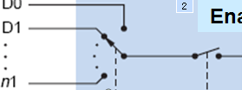
Multiplexer
1. General description of MUX
  n input 1-bit MUX
Enable
EN
SEL
D0
Dn-1
Dn-1
Select En
Log₂(n)-bit
Select
n data sources
data output
Y
1-bit
1-bit
Y=EN·∑( m_{i}·D_{i})

Slide 31
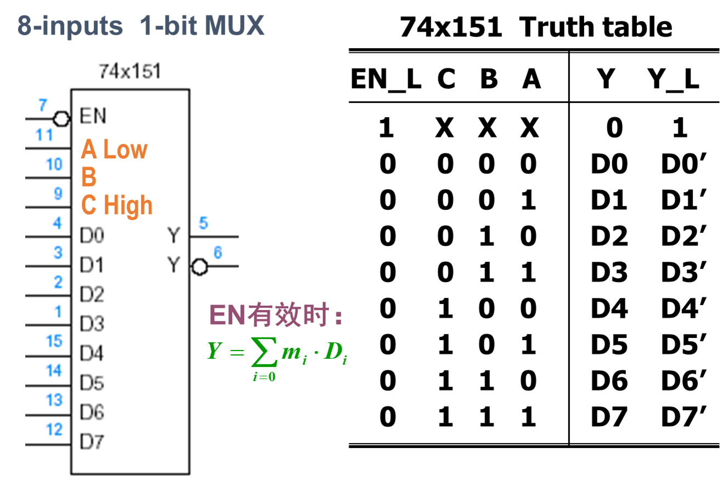
Standard MSI Multiplexer Components

Slide 32


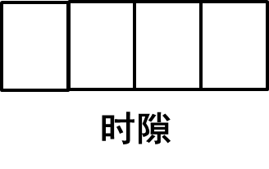






Multiplexer-applications
Application 1: Multiple Data switch
D0
D1
D2
D3
4-to-1
MUX
1-to-4
De-Mux
SEL: 11, 00, 10, 01
SEL: 11, 00, 10, 01
t
0
t
0
t

Slide 33
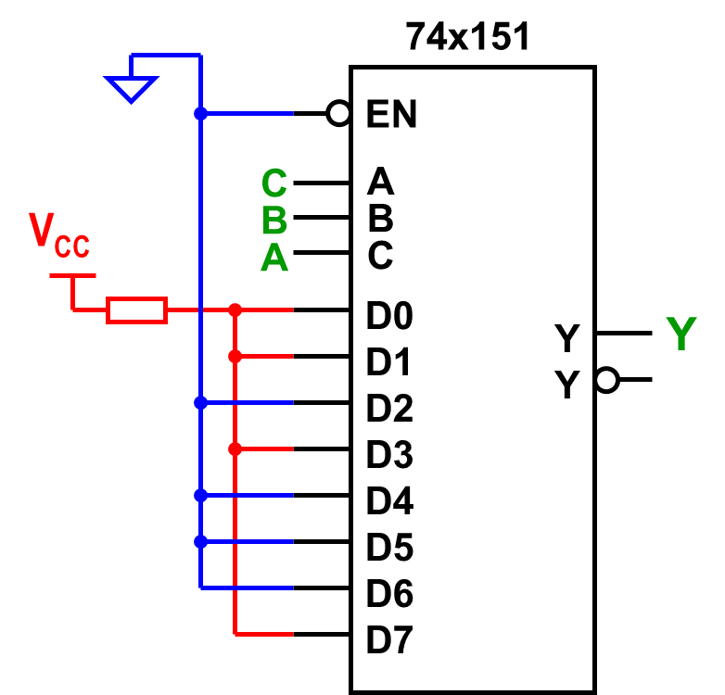
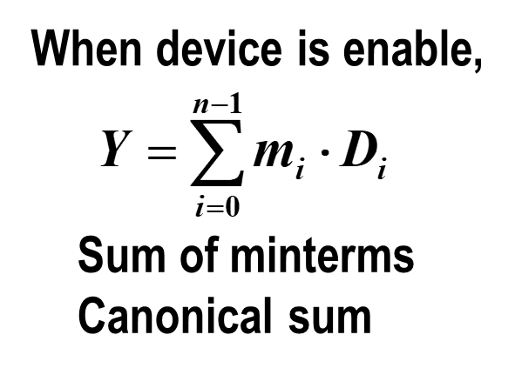
Application 2: Use 74x151 to realize logic function
Example1 : F = Σ_{(A,B,C)}(0,1,3,7)

